Slide 1
Understanding Asset Allocation Using the Efficient Frontier
Modern Portfolio Theory

Slide 2
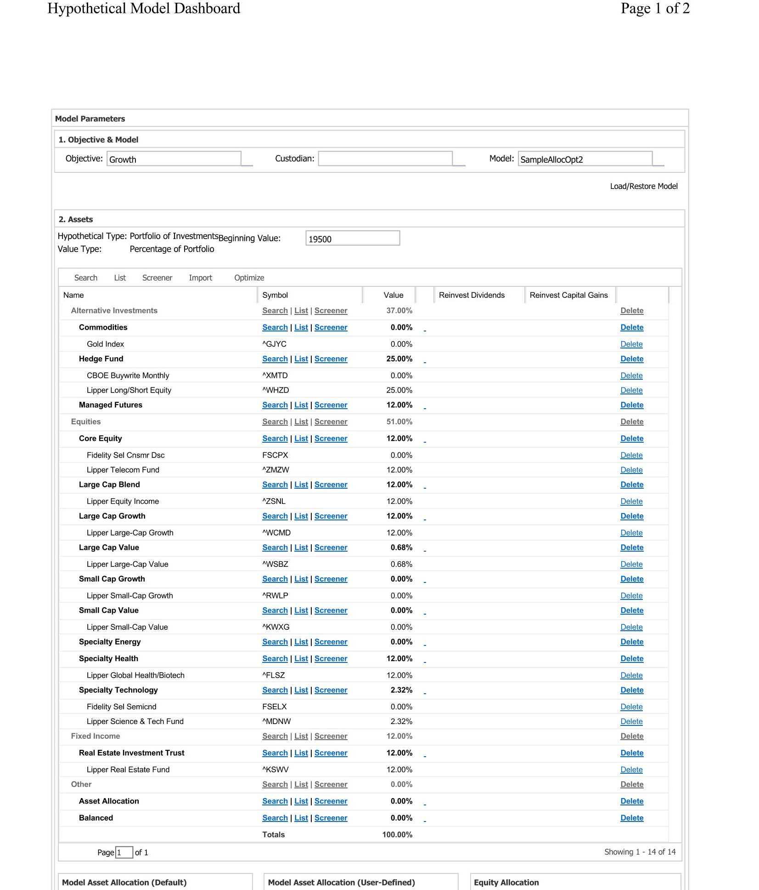
Select from the Universe of 100’s of Possible Asset Classes and impose any planned boundaries or limits before optimizing with algorithms to develop the efficient frontier

Slide 3
When optimized using algorithmic iterations, it provides a spectrum or efficient frontier of portfolio blends each representing a lowest risk/highest return at every given degree of increase of risk and return using known historical data and any overriding assumptions provided.

Slide 4
Each point along the efficient frontier represents an optimization of risk and return, structuring and then picking one is a very personalized process
This is just a random sample of an optimal portfolio blend for a given level of risk and return. This not real or current just for education only.

Slide 5
This allows you to empirically consider the optimization assumptions against known historical data as well as to compare and select from alternate portfolios, (optimized or not) or investment strategies by carefully and reasonably observing not to exceed your maximum level of anticipated acceptable risk, as well as to seek the highest level of possible return for the level of risk you willing to accept.

Slide 6
Ultimately you get to be knowledgeable, understanding and involved in the important, sophisticated investment decision making, objectives and assumptions going in to the very foundation of your very personal and precise asset allocation

Slide 7
William O. Wright, CFP , Guidance Financial & Life Planning Services and Infinity Financial Services Advisory make no guarantees nor provide any assurances that any strategy, investment or model it recommends will in the future produce any lower risk or generate investment returns. All Advisory Services are conducted under the terms of the Client Relationship Services and Advisory Contract brochures of Infinity Financial Services Advisory. This information has been provided intended as for client education only and not to serve as any guide, indication nor assurance of any future result, outcome or performance.

