Slide 2
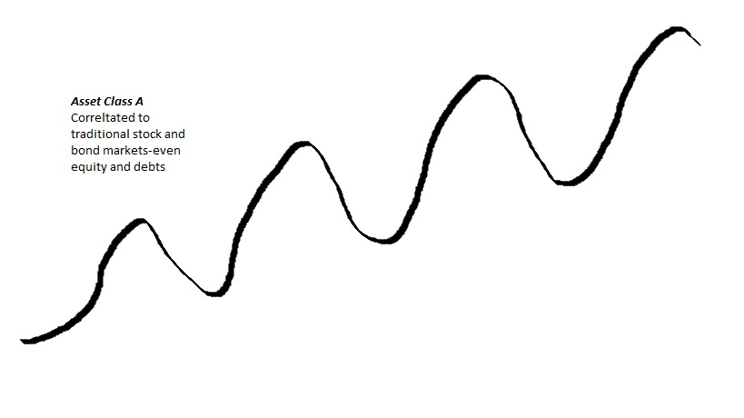
Fluctuations up and down

Slide 3
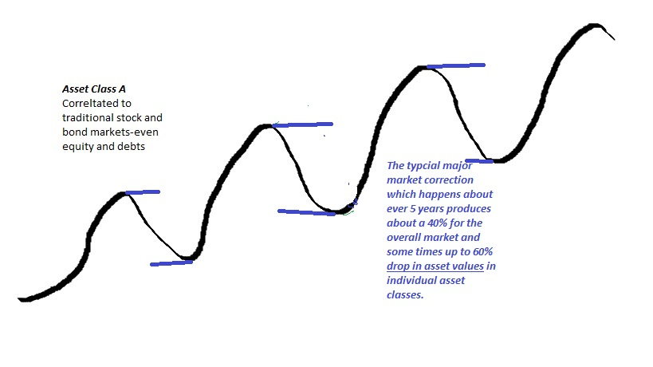
Sometimes these fluctuations are severe

Slide 4
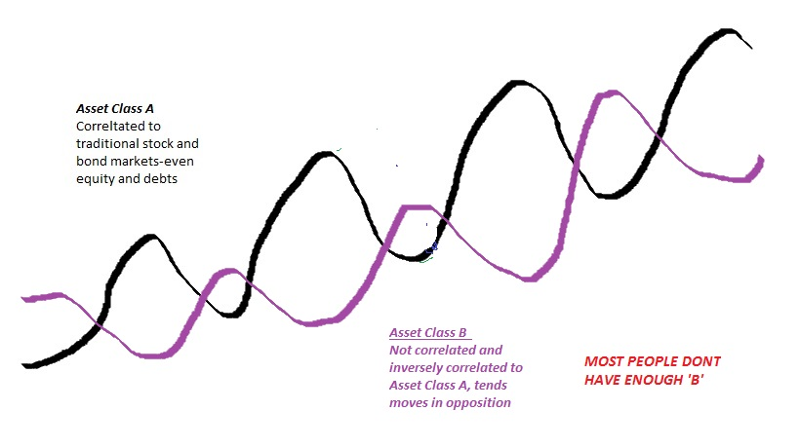
Some assets tend to work opposite of others This is referred to as non-Correlation

Slide 5
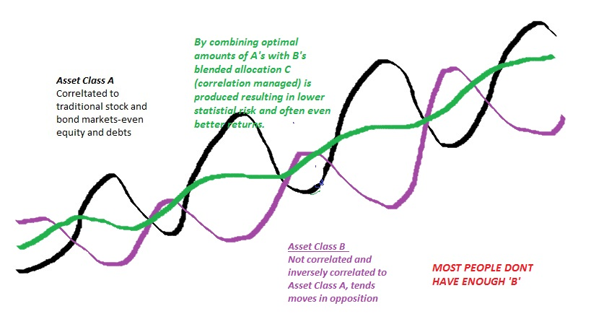
Using the non-Correlated assets can smooth out the ride

Slide 6
Correlation Management is an Imperative part of successful portfolio management and design also known as Asset Allocation

